Slide 1
DATA 606 Fall 2019
Presenter: Sie Siong Wong
Chapter 2: Summarizing Data
Problem 2.33: Stats Scores

Slide 2
Final Exam Scores
20 Statistics Students’ Scores
57, 66, 69, 71, 72, 73, 74, 77, 78, 78, 79, 79, 81, 81, 82, 83, 83, 88, 89, 94
Question:
Create a box plot of the distribution of these scores.

Slide 3
Solution
Use the GGPlot2 to create a box plot.
scores <- c(57, 66, 69, 71, 72, 73, 74, 77, 78, 78, 79, 79, 81, 81, 82, 83, 83, 88, 89, 94)
library(ggplot2)
scores <- data.frame(scores)
ggplot(scores, aes(y=scores)) + geom_boxplot() + labs(title="Distribution of Final Exam Scores") + ylab("Scores") + theme(legend.position = "none", axis.title.x = element_blank(), axis.text.x = element_blank(), axis.ticks.x = element_blank()) + theme(plot.title = element_text(hjust=0.5))

Slide 4
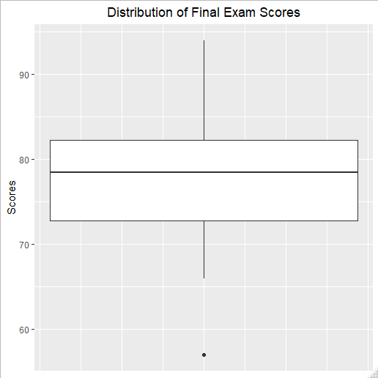
Solution Cont.
Max/Upper Whisker : 94.00
3rd Qu. : 82.25
Median : 78.50
1st Qu. : 72.75
Lower Whisker : 66
Outlier/Min. : 57

Slide 5
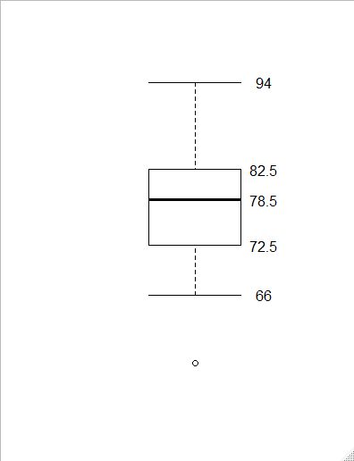
Solution Cont.
Or you can use base R to plot.
boxplot(scores, axes = FALSE, staplewex = 1)
text(y = boxplot.stats(scores)$stats, labels = boxplot.stats(scores)$stats, x = 1.3)

